Slide 1
Third Party Encrypted Storage & Password-less Authentication
Travis Taylor, John Robe, and Daniel James

Slide 2
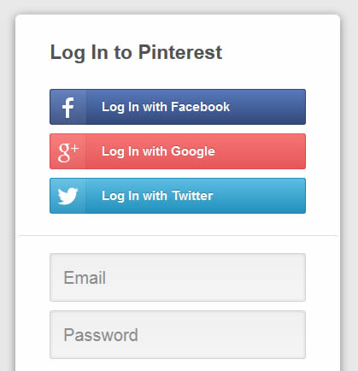
Problem
Remembering (good) passwords is hard
Every website/app that you use wants you to create an account with them
Putting trust in another party (ex. Facebook) is also less than desirable

Slide 3
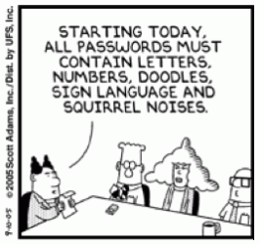
Password Policies Don’t Work
“Starting today, all passwords must contain letters, numbers, doodles, sign language and squirrel noises”

Slide 4
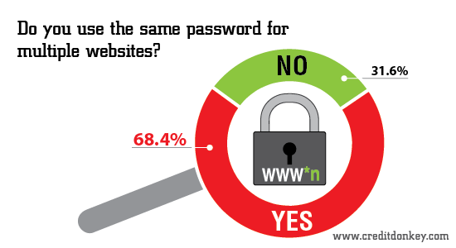
Users Don’t Take Password Security Seriously

Slide 5
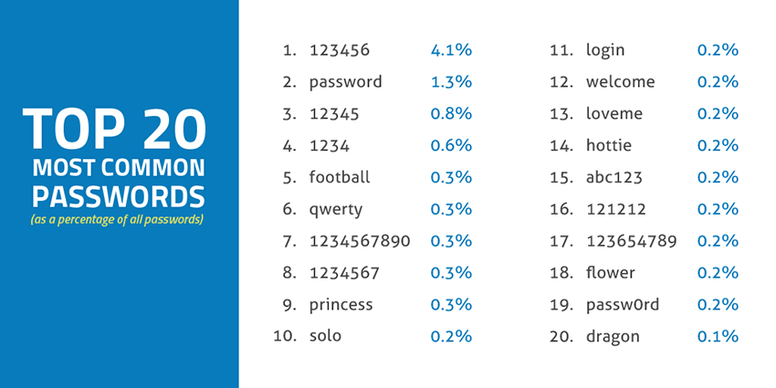
Users Don’t Take Password Security Seriously

Slide 6
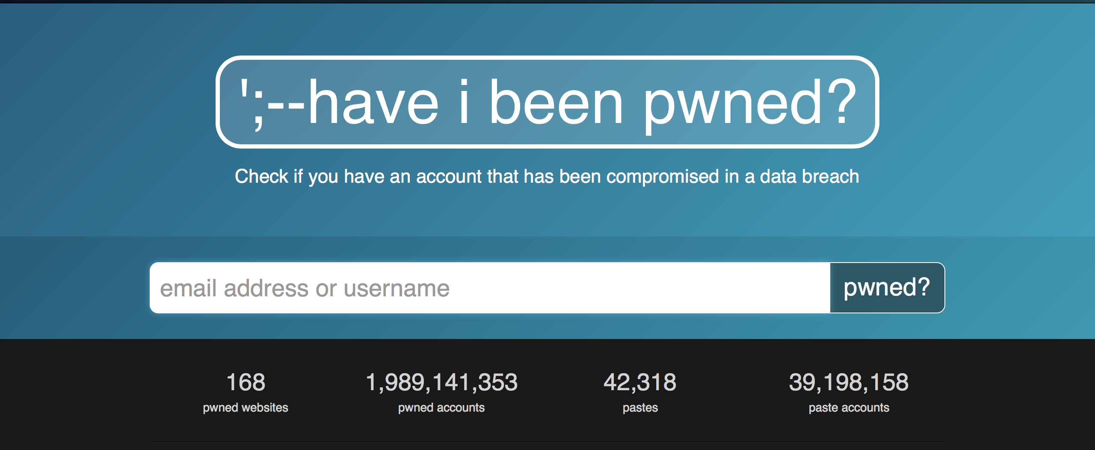
Can’t Trust People With Passwords
Source: https://haveibeenpwned.com

Slide 7
Solution – NO Passwords!
Put our data encrypted in one place
Store decryption key in trusted locations
Decrypt the data in the database
Immediately forget the key afterwards
Four parties:
User
Database Server
Portal Server
User application

Slide 8
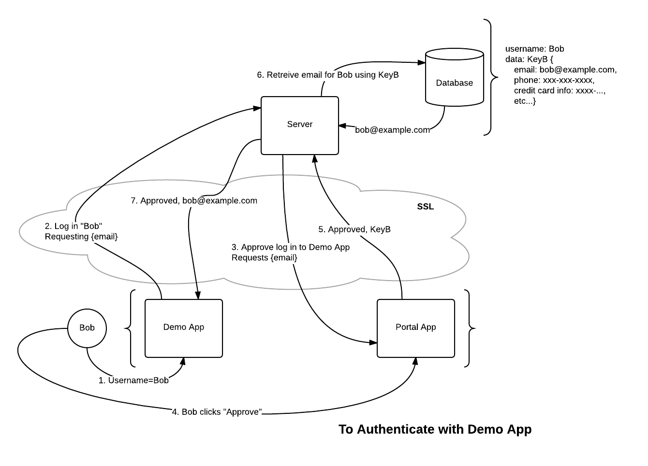
Design

Slide 9
Solution – Example Scenario
User Bob wishes to login to an E-Commerce website that uses our system
That site sends a request to the authentication server
The E-Commerce website opens up a connection to the portal (Bob’s trusted device), the portal asks for Bob’s permission
Bob accepts (or denies) the request, the key that is stored on Bob’s trusted device is sent to the server.
Bob’s address and payment information is decrypted, sent to the E-Commerce site, and then the key is forgotten
Notes:
https://www.websequencediagrams.com/
Application ->Bob: Wants information
Application->Authentication: Request data From server
Application->Portal: Opens connection for Bob
Portal->Bob: Asks permission
Bob->Portal: Grants permission
Portal->Authentication:Sends key
Authentication->Application: Sends decrypted data that was reqeusted

Slide 10
Solution – Potential Adversaries
Obtaining a copy of the database
Secure! Each user’s info is stored encrypted with a unique key that is not stored on the server.
Government/Authority request of data
Secure!
MITM/Impersonation
Secure! (as long as SSL is configured properly.)

Slide 11
Solution – Potential Adversaries
Guessing Passwords / Brute Force
Secure! Only accept password attempts from known trusted devices.
Keys are long and securely generated.
The User Themselves
More secure than passwords.
User’s can’t create a bad key or be phished.
Trusted Device can be compromised.

Slide 12
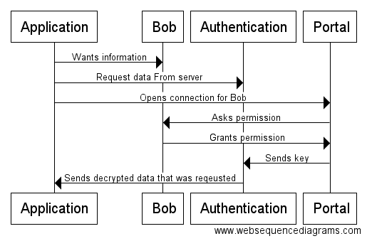
Solution – Message Diagram

Slide 13
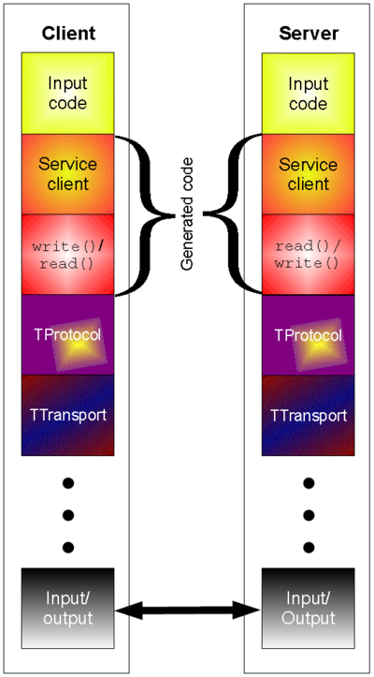
Implementation Details
C++ Server
Apache Thrift for communication (RPC)
Java Demo App
Java Portal App
SSL everywhere

Slide 14
Conclusion - Benefits
The user keeps all his information (email, CC info, phone #, etc…) in one place.
Even if the authentication server is compromised, all of the data is encrypted, and the key doesn’t exist on that system.
The user doesn’t have to remember a password. The user can’t choose a weak password.

Slide 15
Conclusion - Problems
Replacing “forgot my password” problem with “lost my device” problem.
User can have multiple trusted devices (each with a copy of a key)
Give users a “recovery key”
The key exists on the server for a brief period of time.
User’s must trust the Authentication Server’s organization with their data.

Slide 16

Questions? Comments? Concerns?

